Slide 1
Student Registration Website
Created By: Tyler McMullen
CST: 499
Prof. Elchouemi
06/15/2022

Slide 2
SRS
The Software Requirement Specification provides an outline for the student registration website requirements.
Functions: User can register an account that saves their information
User Will be able to log into the website using that information
Website will have a dropdown list showing available courses
User will be able to enroll in courses
User will be able to view their information once logged in

Slide 3
SRS CONT.
Features:
Course Search - Users can search through the database for the specified course via a search bar with additional features. This is a main feature of the website and has a high priority of 9.
Register - Users will have to register an account to browse available courses. The user information is saved for logging in. Priority 10.
Login - Users will be able to login after creating an account. They will enter their saved username and password. Priority 10.
Enroll - Once logged in, the user can browse a selection of Courses available. They will be able to select the course and an option to enroll will be present. The course will also indicate the number of open slots and the course term.

Slide 4
UML
Unified Modeling Language is the standardization modeling language of a group of diagrams that assist in development.
Class
Sequence
Use Case

Slide 5
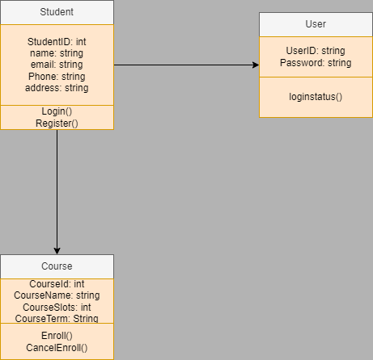
Class
Class diagram shows the structure of the system by visually showing the classes, attributes, methods and relationships among objects.

Slide 6
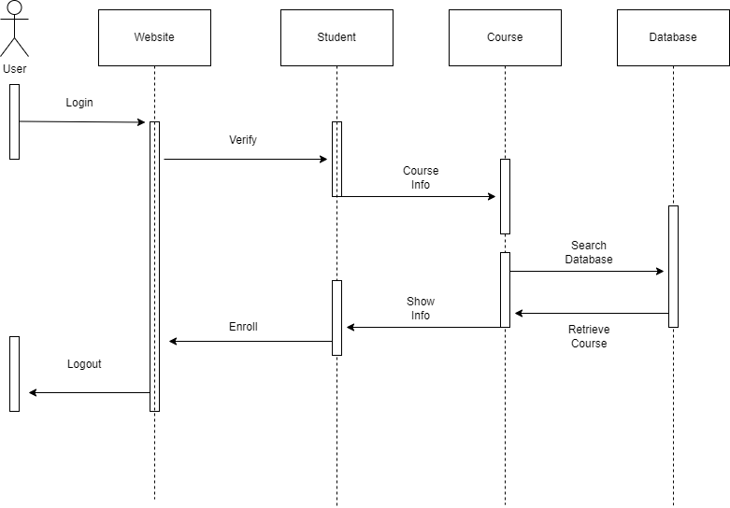
Sequence
Sequence diagrams show the sequence of interactions for classes over time.

Slide 7
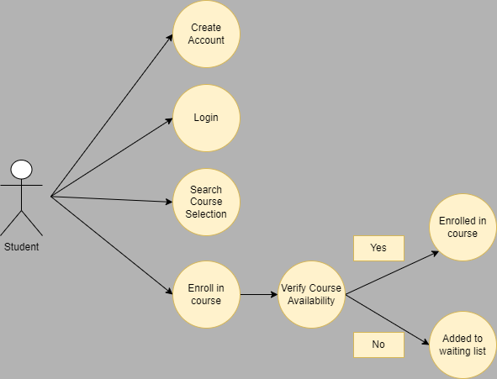
Use Case
Use case is a behavior diagram that utilize actors and use cases. A use case is a set of actions/functions the systems performs from the perspective of the user/actor.

Slide 8
User Interface
There are multiple interfaces for this website including a registration page, login page, course registration page, and profile page.

Slide 9
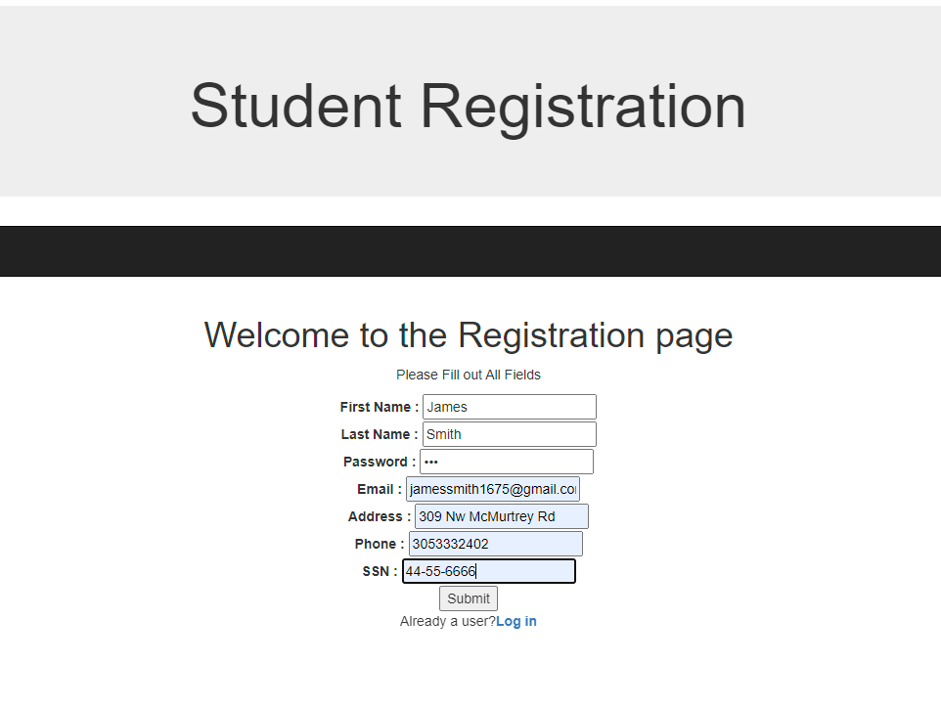
Registration
The registration page is where users will provide input for their information that will be stored into a MYSQL database table.

Slide 10
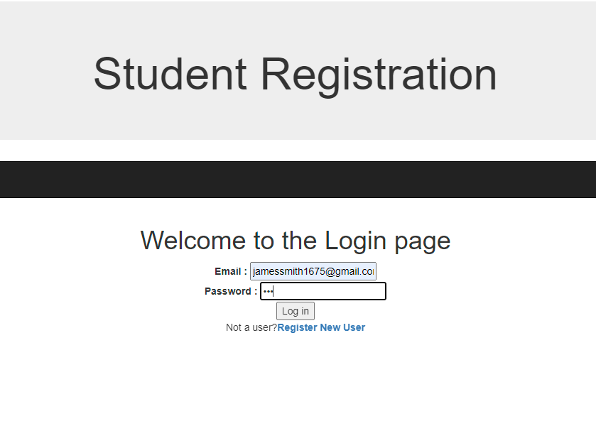
Login
The login page is where the user will enter their login information that is saved inside the database for verification.

Slide 11
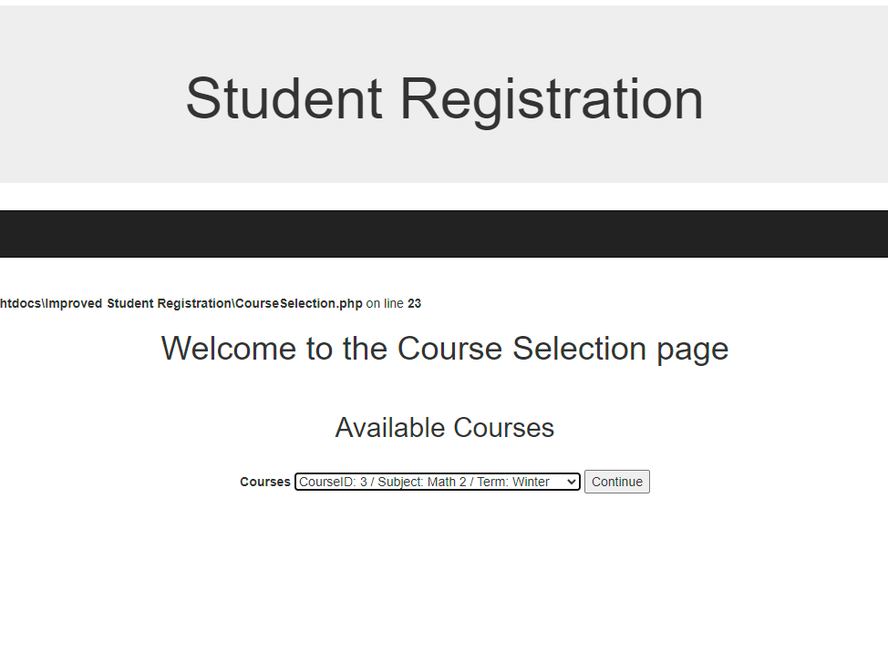
Course Enroll
The course enroll page allows users to utilize a dropdown list of available courses where they can enroll in their selected course.

Slide 12
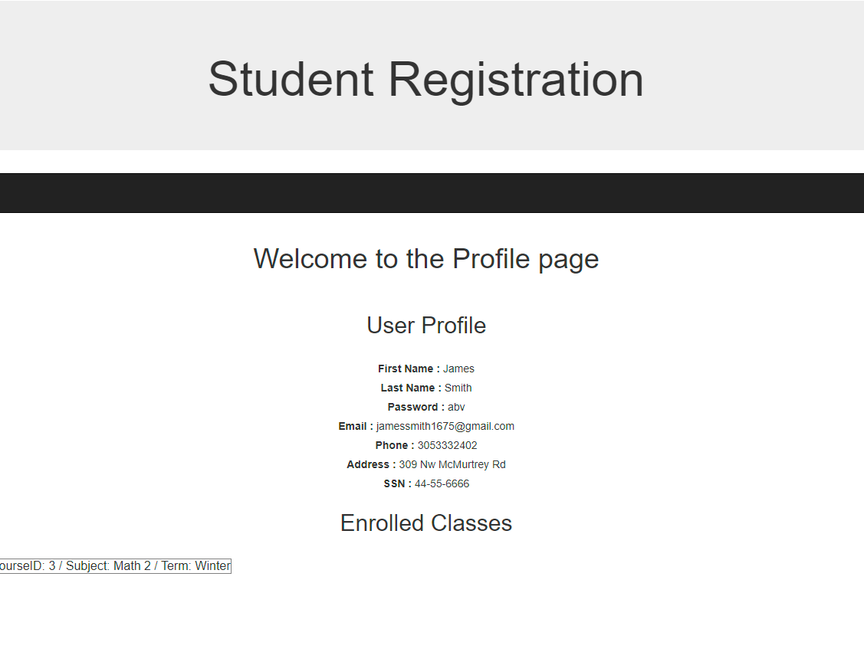
Profile
The profile page displays the user’s personal information as well as their enrolled courses.

Slide 13
MYSQL DATABASE
A MYSQL database was created that will store information inside multiple tables.
Tbluser – Table that stores user information
Courses – Table that stores course information (ID, Subject, Term)
Stdclass – Table that will associate a logged in user with a selected course for enrollment

Slide 14
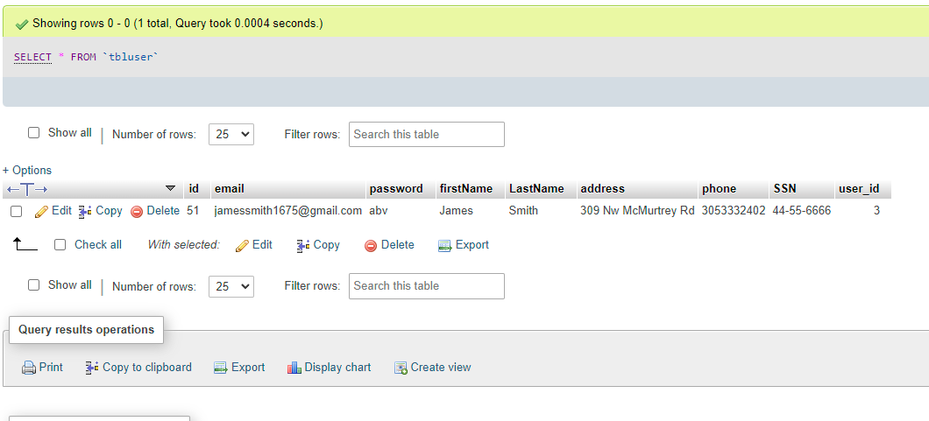
tbluser

Slide 15
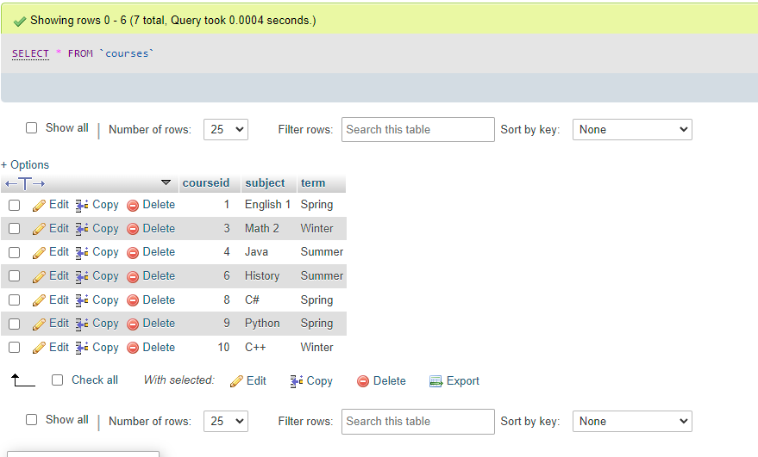
Courses

Slide 16
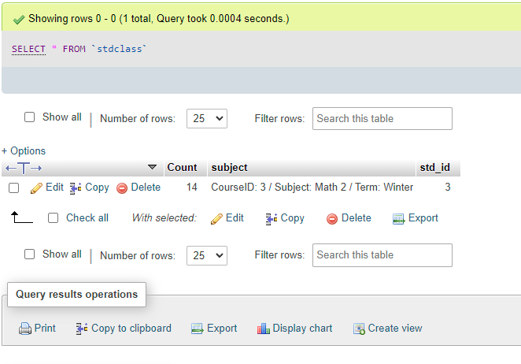
stdclass

Slide 17
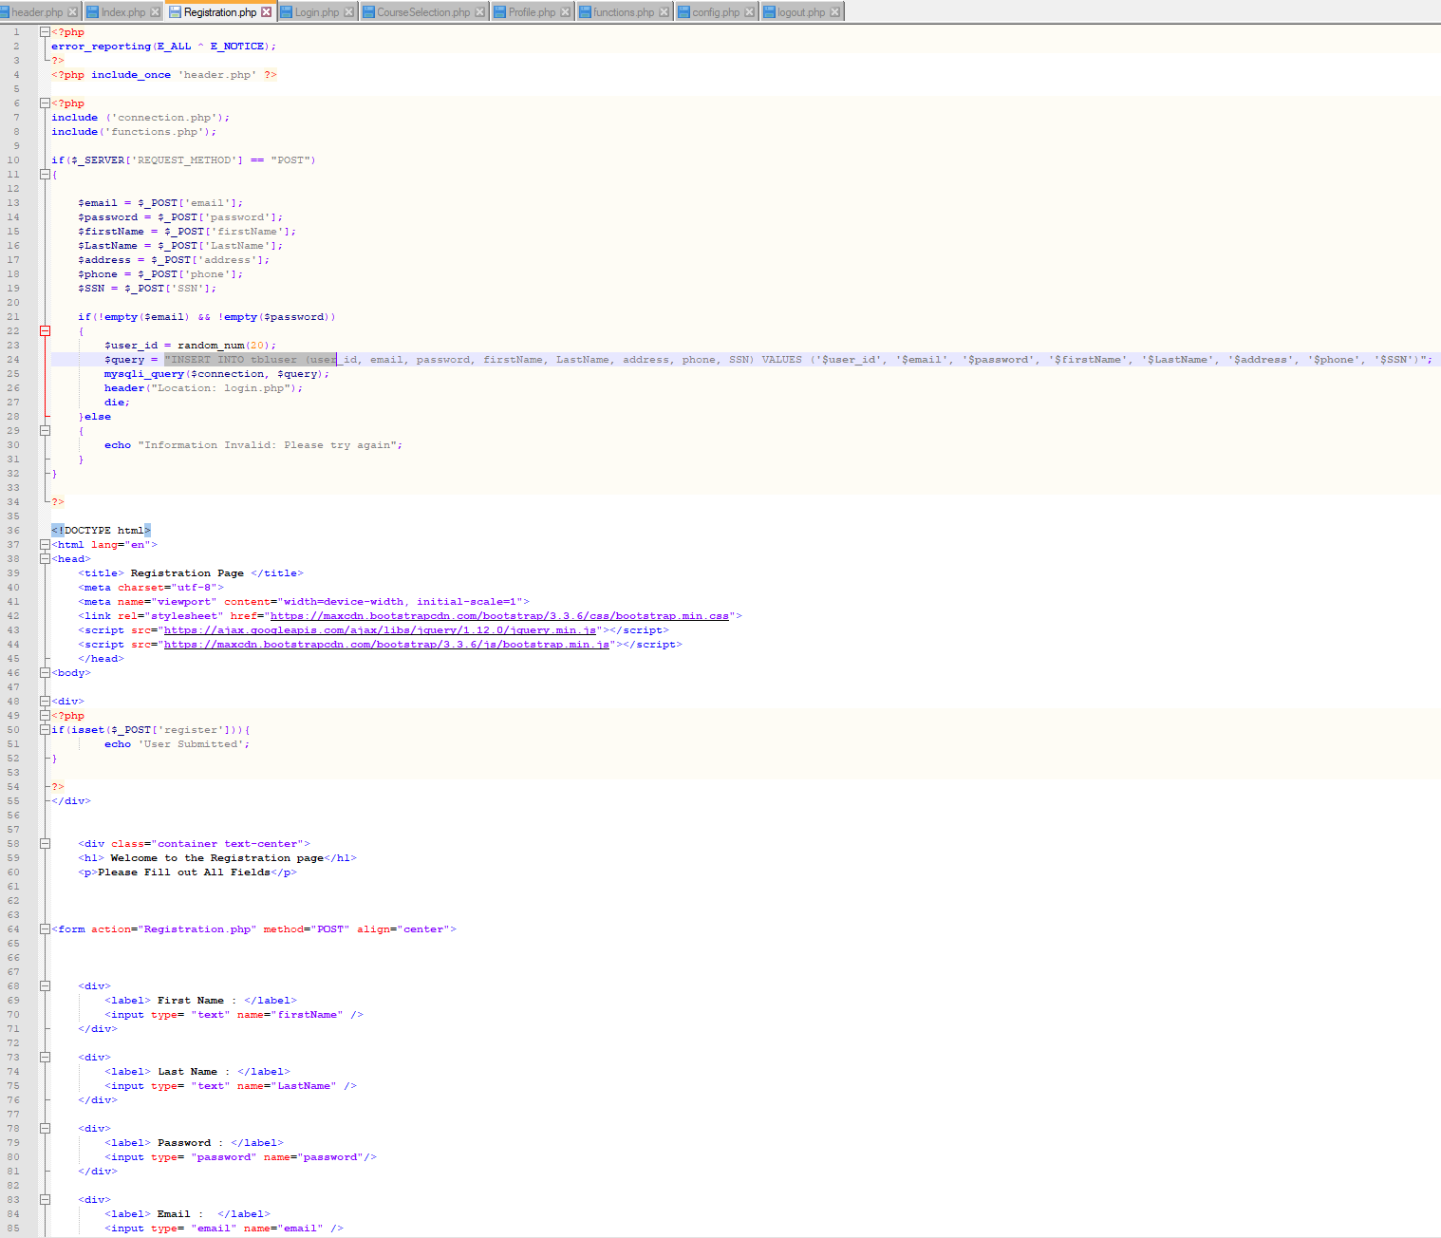
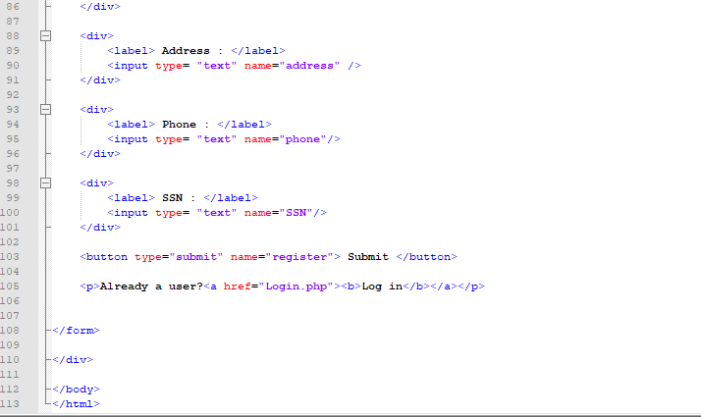
Registration Code

Slide 18
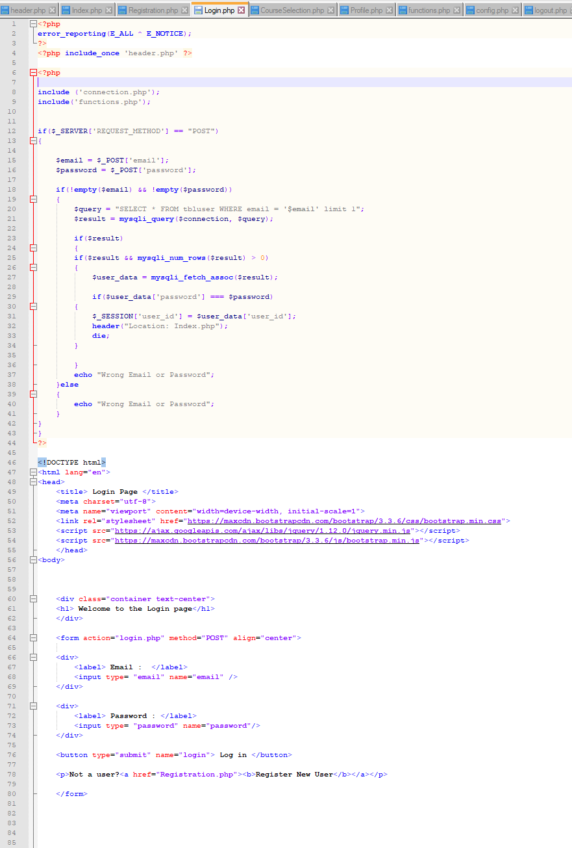
Login Code

Slide 19
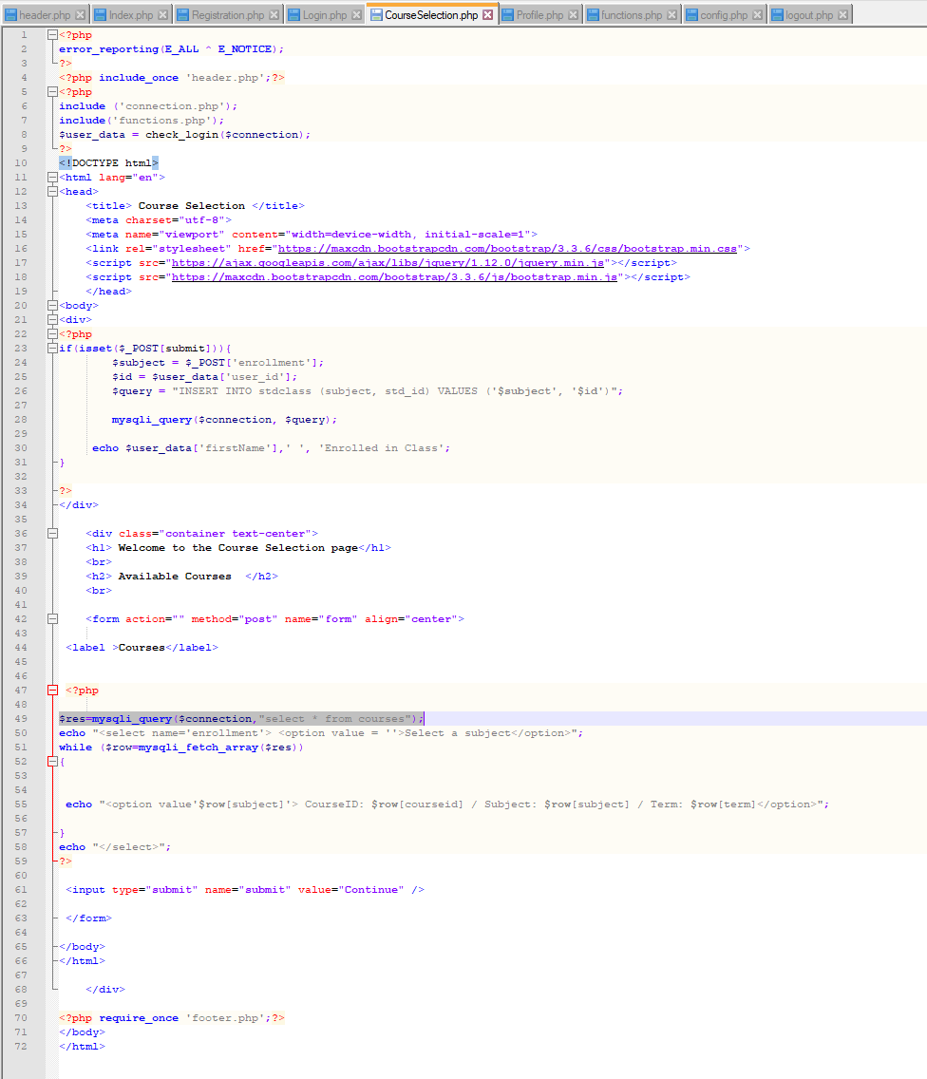
Course Selection Code

Slide 20
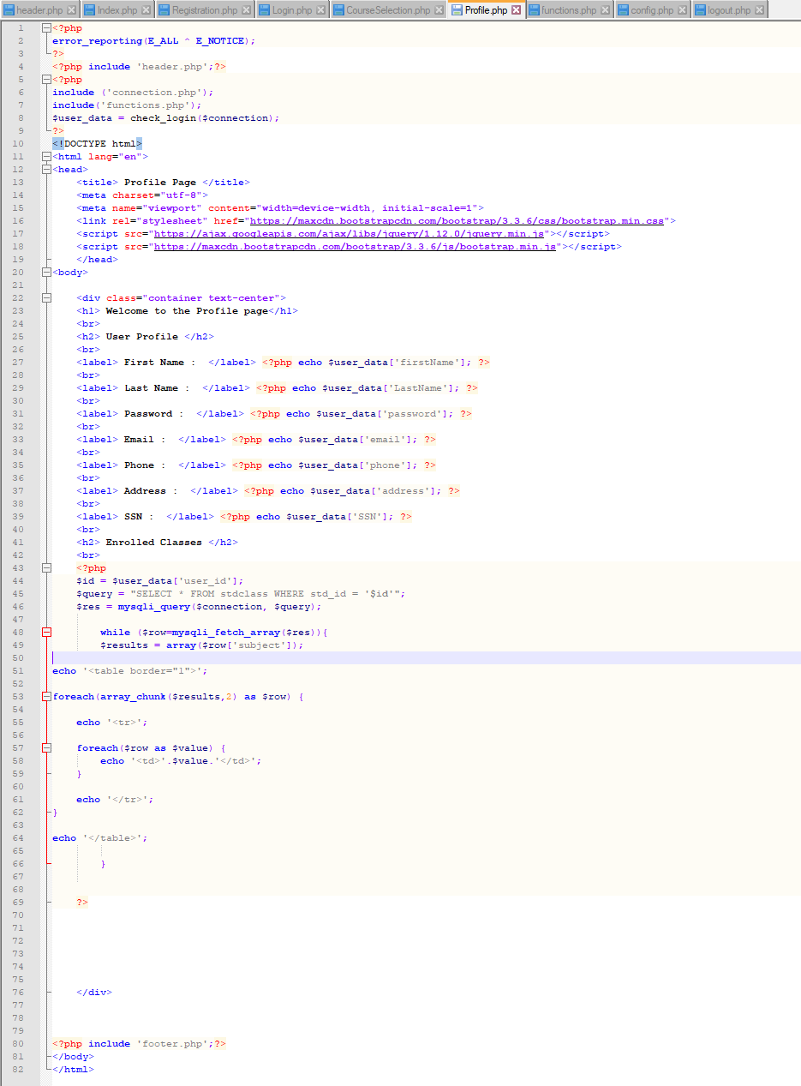
Profile Code

